Slide 1


Lecture 16: Coreference Resolution Determining who is who and what is what
Harvard IACS
Chris Tanner

Slide 2

COREFERENCE RESOLUTIONARY
“You would rather have a Lexus or justice? A dream or some substance? A Bimmer, a necklace, or freedom?
-- Dead Prez

Slide 3
ANNOUNCEMENTS
HW4 is out
HW2 and Phase 2 are Quiz 5 have been graded
Research Project Phase 3 due Oct 28 (Thurs) @ 11:59pm

Slide 4
Outline
Coreference Resolution
Conjoined CNN
Neural Clustering
Results
Improvements
Leveraging Data
No Data
Better Data
Additional Research

Slide 5
Outline
Coreference Resolution
Conjoined CNN
Neural Clustering
Results
Improvements
Leveraging Data
No Data
Better Data
Additional Research

Slide 6
Outline
Coreference Resolution
Conjoined CNN
Neural Clustering
Results
Improvements
Leveraging Data
No Data
Better Data
Additional Research

Slide 7
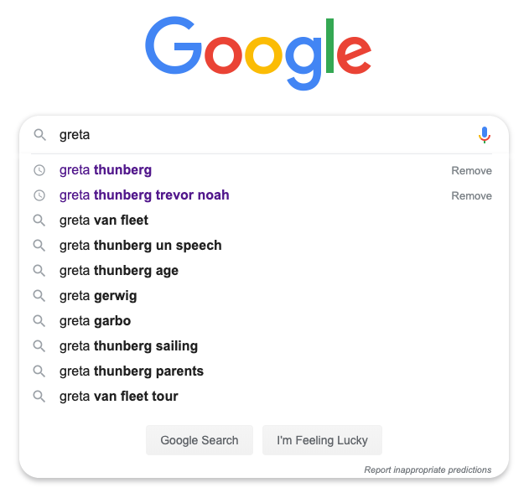
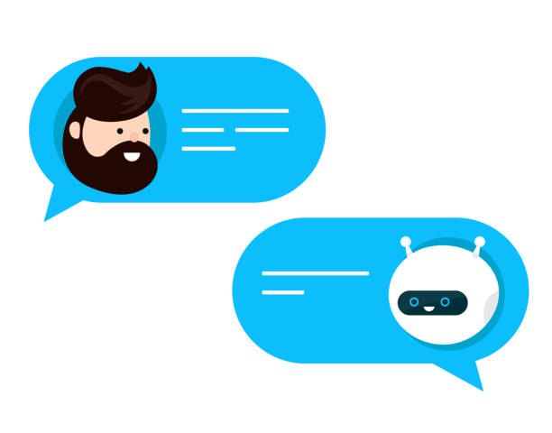
Discourse
These systems hinge upon understanding what you’re saying (discourse) and the meaning of it (semantics)
Notes:
Despite language being very tricky and nuanced, we’ve clearly made significant strives as a field. Apparent by the real-world applications such as Google Translate, voice assistants, power search engines, and chatbots

Slide 8


Discourse
Also necessary for information retrieval, question-answering, document summarization, etc
“TL;DR crypto stocks are surging”
Event coreference for information extraction. Humphreys et al., 1997
Question answering based on semantic structures. Narayanan and Harabagiu, 2004
Sub-event based multi-document summarization. Daniel et al., 2003

Slide 9
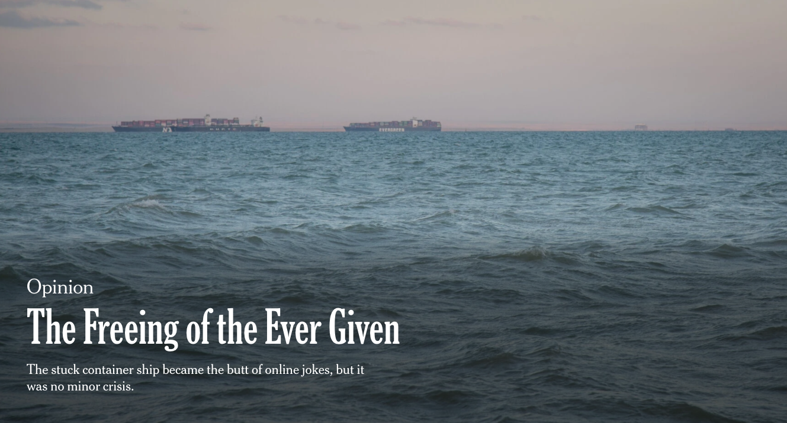
Notes:
If we, as a human, pick a random news article such as this one.

Slide 10

In the end, a full moon succeeded where puny machines could not, wrenching the mammoth barge out of the Egyptian mud in which it became wedged six days earlier. A spring tide finally set the Ever Given and its enormous stack of 18,300 shipping containers afloat again, drawing cheers from Egyptians on the shore and a virtual world beyond.
Notes:
As we read it, left to right, we build up a mental model of what’s going on.

Slide 11
In the end, a full moon succeeded where puny machines could not, wrenching the mammoth barge out of the Egyptian mud in which it became wedged six days earlier. A spring tide finally set the Ever Given and its enormous stack of 18,300 shipping containers afloat again, drawing cheers from Egyptians on the shore and a virtual world beyond.
Notes:
When we reach the mention “mammoth barge”, we wonder what is this. We don’t yet know what it’s referring to, but that’s okay. We’ll add it to our mental narrative of what’s going on.

Slide 12
In the end, a full moon succeeded where puny machines could not, wrenching the mammoth barge out of the Egyptian mud in which it became wedged six days earlier. A spring tide finally set the Ever Given and its enormous stack of 18,300 shipping containers afloat again, drawing cheers from Egyptians on the shore and a virtual world beyond.
Notes:
I’m coloring it here, just for aesthetic, to indicate that it is clearly some entity, some object, that we should probably care about.

Slide 13
In the end, a full moon succeeded where puny machines could not, wrenching the mammoth barge out of the Egyptian mud in which it became wedged six days earlier. A spring tide finally set the Ever Given and its enormous stack of 18,300 shipping containers afloat again, drawing cheers from Egyptians on the shore and a virtual world beyond.
Notes:
When we encounter “Egyptian mud”, this also appears like an entity, but it is distinctly different from the “mammoth barge.” So, here, I will color it with a different color, just to indicate that these things aren’t referring to the same item.

Slide 14
In the end, a full moon succeeded where puny machines could not, wrenching the mammoth barge out of the Egyptian mud in which it became wedged six days earlier. A spring tide finally set the Ever Given and its enormous stack of 18,300 shipping containers afloat again, drawing cheers from Egyptians on the shore and a virtual world beyond.

Slide 15
In the end, a full moon succeeded where puny machines could not, wrenching the mammoth barge out of the Egyptian mud in which it became wedged six days earlier. A spring tide finally set the Ever Given and its enormous stack of 18,300 shipping containers afloat again, drawing cheers from Egyptians on the shore and a virtual world beyond.
Notes:
Yet, when we reach the pronoun “it”, we immediately know it’s referring to the “mammoth barge”, not the “Egyptian mud” or a new concept.

Slide 16
In the end, a full moon succeeded where puny machines could not, wrenching the mammoth barge out of the Egyptian mud in which it became wedged six days earlier. A spring tide finally set the Ever Given and its enormous stack of 18,300 shipping containers afloat again, drawing cheers from Egyptians on the shore and a virtual world beyond.

Slide 17
In the end, a full moon succeeded where puny machines could not, wrenching the mammoth barge out of the Egyptian mud in which it became wedged six days earlier. A spring tide finally set the Ever Given and its enormous stack of 18,300 shipping containers afloat again, drawing cheers from Egyptians on the shore and a virtual world beyond.

Slide 18
In the end, a full moon succeeded where puny machines could not, wrenching the mammoth barge out of the Egyptian mud in which it became wedged six days earlier. A spring tide finally set the Ever Given and its enormous stack of 18,300 shipping containers afloat again, drawing cheers from Egyptians on the shore and a virtual world beyond.

Slide 19
In the end, a full moon succeeded where puny machines could not, wrenching the mammoth barge out of the Egyptian mud in which it became wedged six days earlier. A spring tide finally set the Ever Given and its enormous stack of 18,300 shipping containers afloat again, drawing cheers from Egyptians on the shore and a virtual world beyond.

Slide 20
In the end, a full moon succeeded where puny machines could not, wrenching the mammoth barge out of the Egyptian mud in which it became wedged six days earlier. A spring tide finally set the Ever Given and its enormous stack of 18,300 shipping containers afloat again, drawing cheers from Egyptians on the shore and a virtual world beyond.

Slide 21
In the end, a full moon succeeded where puny machines could not, wrenching the mammoth barge out of the Egyptian mud in which it became wedged six days earlier. A spring tide finally set the Ever Given and its enormous stack of 18,300 shipping containers afloat again, drawing cheers from Egyptians on the shore and a virtual world beyond.

Slide 22
In the end, a full moon succeeded where puny machines could not, wrenching the mammoth barge out of the Egyptian mud in which it became wedged six days earlier. A spring tide finally set the Ever Given and its enormous stack of 18,300 shipping containers afloat again, drawing cheers from Egyptians on the shore and a virtual world beyond.
Notes:
In our mind, we’ve **resolved** which words all refer to the same underlying thing.

Slide 23
Coreference Resolution
In the end, a full moon succeeded where puny machines could not, wrenching the mammoth barge out of the Egyptian mud in which it became wedged six days earlier. A spring tide finally set the Ever Given and its enormous stack of 18,300 shipping containers afloat again, drawing cheers from Egyptians on the shore and a virtual world beyond.
The task of determining which words all refer to the same underlying real-world thing
Notes:
And that’s exactly what Coref Resolution is. I’m deliberately being abstract here by saying “thing”

Slide 24
Coreference Resolution
In the end, a full moon succeeded where puny machines could not, wrenching the mammoth barge out of the Egyptian mud in which it became wedged six days earlier. A spring tide finally set the Ever Given and its enormous stack of 18,300 shipping containers afloat again, drawing cheers from Egyptians on the shore and a virtual world beyond.
The task of determining which words all refer to the same underlying real-world thing
EASY FOR HUMANS
Notes:
This task is easy for humans. Rarely do we need to ask people to clarify, ”when you said ‘he’, are you referring to person A or B”

Slide 25
State-of-the-art neural model?
In the end, a full moon succeeded where puny machines could not, wrenching the mammoth barge out of the Egyptian mud in which it became wedged six days earlier. A spring tide finally set the Ever Given and its enormous stack of 18,300 shipping containers afloat again, drawing cheers from Egyptians on the shore and a virtual world beyond.
End-to-end Neural Coreference Resolution. Lee et al. 2017
Notes:
However, if you use a state-of-the-art model, one that has been incredibly influential, we see that even in this simple example, it fails to know that “mammoth barge” and “Ever Given are the same thing.

Slide 26
State-of-the-art neural model?
In the end, a full moon succeeded where puny machines could not, wrenching the mammoth barge out of the Egyptian mud in which it became wedged six days earlier. A spring tide finally set the Ever Given and its enormous stack of 18,300 shipping containers afloat again, drawing cheers from Egyptians on the shore and a virtual world beyond.
End-to-end Neural Coreference Resolution. Lee et al. 2017
Notes:
Thus, it wouldn’t be able to leverage this information and know that it’s a “mammoth barge”

Slide 27
In the end, a full moon succeeded where puny machines could not, wrenching the mammoth barge out of the Egyptian mud in which it became wedged six days earlier. A spring tide finally set the Ever Given and its enormous stack of 18,300 shipping containers afloat again, drawing cheers from Egyptians on the shore and a virtual world beyond.
HARD FOR COMPUTERS
Notes:
This is difficult for computers. Whereas many NLP tasks have seen significant progress made in the past 5 years, largely due to Deep Learning, coref resolution is one where we’re still just slowly chipping away and making incremental gains for the past 10 years.

Slide 28
Types of referring expressions
Indefinite noun phrases:
I saw an incredible oak tree today
Definite noun phrases:
I read about it in the New York Times
Pronominal mentions:
Emily aced the quiz, as she expected
Nominal mentions and names:
The amazing marathoner, Des Linden, is a true inspiration
Demonstratives:
These pretzels are making me thirsty.
This, that, these, those

Slide 29
Good models should be able to perform coreference resolution across multiple documents
Notes:
The previous example was just on a single document, but a good model ought to be able to operate across multiple documents, linking together all co-referring mentions.

Slide 30

In the end, a full moon succeeded where puny machines could not, wrenching the mammoth barge out of the Egyptian mud in which it became wedged six days earlier. A spring tide finally set the Ever Given and its enormous stack of 18,300 shipping containers afloat again, drawing cheers from Egyptians on the shore and a virtual world beyond.
SUEZ, Egypt (AP) — Experts boarded the massive container ship Tuesday that had blocked Egypt’s vital Suez Canal and disrupted global trade for nearly a week, seeking answers to a single question that could have billions of dollars in legal repercussions: What went wrong?

Slide 31




And handle events

Slide 32
In the end, a full moon succeeded where puny machines could not, wrenching the mammoth barge out of the Egyptian mud in which it became wedged six days earlier. A spring tide finally set the Ever Given and its enormous stack of 18,300 shipping containers afloat again, drawing cheers from Egyptians on the shore and a virtual world beyond.
SUEZ, Egypt (AP) — Experts boarded the massive container ship Tuesday that had blocked Egypt’s vital Suez Canal and disrupted global trade for nearly a week, seeking answers to a single question that could have billions of dollars in legal repercussions: What went wrong?

Slide 33
In the end, a full moon succeeded where puny machines could not, wrenching the mammoth barge out of the Egyptian mud in which it became wedged six days earlier. A spring tide finally set the Ever Given and its enormous stack of 18,300 shipping containers afloat again, drawing cheers from Egyptians on the shore and a virtual world beyond.
SUEZ, Egypt (AP) — Experts boarded the massive container ship Tuesday that had blocked Egypt’s vital Suez Canal and disrupted global trade for nearly a week, seeking answers to a single question that could have billions of dollars in legal repercussions: What went wrong?

Slide 34
cluster₆
cluster₁
cluster₃
Egyptians
mammoth barge
Experts
cluster₅
it
cluster₄
Egyptian mud
Ever Given
Suez Canal
its
cluster₁₀
container ship
cluster₈
cluster₉
boarded
drawing cheers
disrupted
cluster₂
cluster₇
wedged
set afloat
cluster₁₃
cluster₁₁
cluster₁₂
blocked
succeeded
wrenching
seeking

Slide 35
cluster₆
cluster₁
cluster₃
Egyptians
mammoth barge
Experts
Takeaway #1
cluster₅
it
cluster₄
Coreference resolution determines which mentions all refer to the same underlying entity or event, and is ultimately a clustering task.
Egyptian mud
Ever Given
Suez Canal
its
cluster₁₀
container ship
cluster₈
cluster₉
boarded
drawing cheers
disrupted
cluster₂
cluster₇
wedged
set afloat
cluster₁₃
cluster₁₁
cluster₁₂
blocked
succeeded
wrenching
seeking

Slide 36
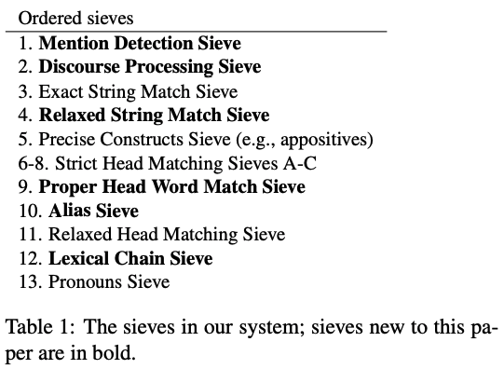
Entity Coreference (2010 – present)
Early research demonstrated highly-effective rule-based entity coref systems
CoNLL F1: 58.3
A Multi-Pass Sieve for Coreference Resolution. Raghunathan et al. EMNLP 2010
Stanford’s Multi-Pass Sieve Coreference Resolution System. Lee et al. CoNLL 2011
Notes:
The coreference method proposed by Stanford University at the CoNLL 2011 shared task (Pradhan et al., 2011) is a deterministic system consisting of a set of sieves applied in a cascade fashion. Initially, each mention is considered as a singleton cluster. Then, with a procedure that has some analogies with agglomerative clustering, the clusters are sequentially processed by the sieves. Each sieve embodies a specific linguistic rule and builds on the result of the previous one by merging a mention into an antecedent partially-formed entity cluster, depending on whether it satisfies a set of constraints. The architecture guarantees that high-precision constraints are given high priority, while rules with lower precision but higher recall are applied later.

Slide 37
Entity Coreference (2010 – present)
Rule 1: cluster together all entity mentions that are identical
The Ever Given cargo ship has been stuck for the past six days. While reports of Ever Given started to …
A Multi-Pass Sieve for Coreference Resolution. Raghunathan et al. EMNLP 2010
Stanford’s Multi-Pass Sieve Coreference Resolution System. Lee et al. CoNLL 2011

Slide 38
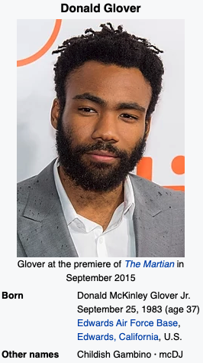
Entity Coreference (2010 – present)
Rule 10: cluster together all entity mentions that are aliases according to Wikipedia
Donald Glover, better known as Childish Gambino, has written and produced an incredible TV series titled Atlanta.
A Multi-Pass Sieve for Coreference Resolution. Raghunathan et al. EMNLP 2010
Stanford’s Multi-Pass Sieve Coreference Resolution System. Lee et al. CoNLL 2011

Slide 39
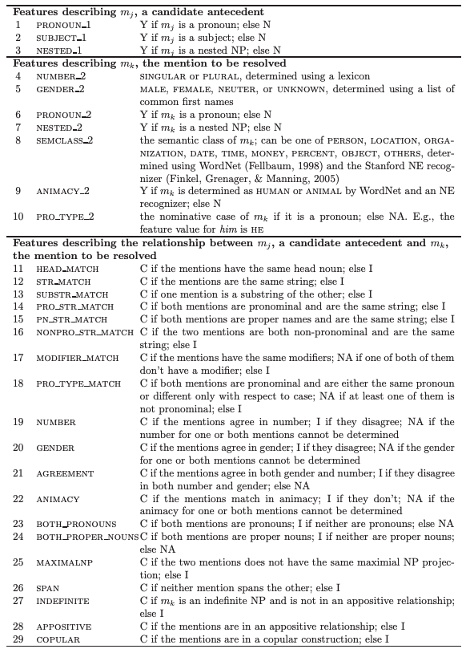
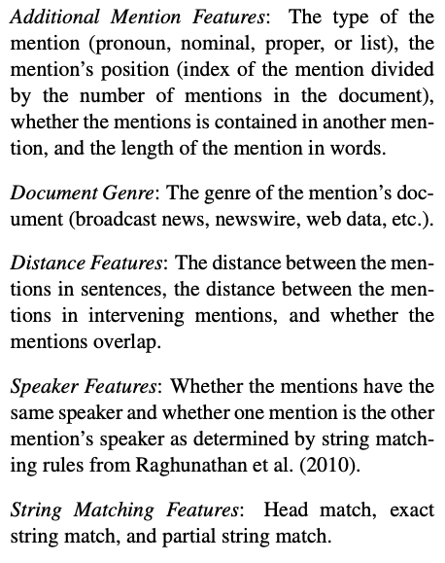
Entity Coreference (2011 – present)
Then, many systems threw tons of manually-defined features into their models
CoNLL F1: 65.3
Narrowing the Modeling Gap: A Cluster-Ranking Approach to Coreference Resolution. Rahman and Ng. JAIR 2011
Improving Coreference Resolution by Learning Entity-Level Distributed Representations. Clark and Manning. ACL 2016

Slide 40
Entity Coreference (2011 – present)
Takeaway #2
Then, many systems threw tons of manually-defined features into their models
Research has largely relied on ML models w/ many manually-defined features.
Strong results but clear limitations.
Narrowing the Modeling Gap: A Cluster-Ranking Approach to Coreference Resolution. Rahman and Ng. JAIR 2011
Improving Coreference Resolution by Learning Entity-Level Distributed Representations. Clark and Manning. ACL 2016

Slide 41
Event Coreference (2014 - present)
ECB+ corpus has 982 short documents
Actress Lindsay Lohan finally checked into court-mandated rehab at the Betty Ford Center late Thursday.
Lindsay Lohan checked into the Betty Ford Clinic in Rancho Mirage, California on Thursday night, for what is to be a three-month stay, her rep confirms to People.

Slide 42
Event Coreference (2014 - present)
SameLemma: if two mentions have the same lemma (base form), classify them as being coref!
Original word
Lemmatization
running
run
ran
run
This shouldn’t work so well, but it does.

Slide 43
Outline
Coreference Resolution
Conjoined CNN
Neural Clustering
Results
Improvements
Leveraging Data
No Data
Better Data
Additional Research

Slide 44
Outline
Coreference Resolution
Conjoined CNN
Neural Clustering
Results
Improvements
Leveraging Data
No Data
Better Data
Additional Research

Slide 45
cluster₁
mammoth
barge
?
it
Ever Given
its
container ship
corpus
cluster₃
Coreference resolution
Experts
Notes:
Our input is always a set of documents. Raw text.
Our output is clusters of mentions.
So, coref is this magical part in the middle, and every system effectively has the same 3 components.

Slide 46
cluster₁
mammoth
barge
Mention
Detection
Mention
Pair Model
it
Clustering
Ever Given
its
container ship
corpus
cluster₃
Coreference resolution
Experts

Slide 47
cluster₁
mammoth
barge
Mention
Detection
Mention
Pair Model
it
Clustering
Ever Given
its
container ship
corpus
cluster₃
Coreference resolution
Experts

Slide 48
Mention Detection
Determines which spans of words constitute a mention
4.6 Magnitude Quake Recorded in Sonoma County
An earthquake with a preliminary magnitude of 4.6 was recorded in the North Bay this morning, according to the U.S. Geological Survey. The quake occurred at 2:09 a.m. about 14 miles north-northeast of Healdsburg and had a depth of 1.2 miles. It was followed by a 2.9 aftershock at 2:12 a.m. and a 2.2 at 2:15 a.m… there are no reports of injuries or major damage.
4.6 Magnitude Quake Rattles Sonoma County Early Thursday
An earthquake measuring 4.6 rattled Sonoma and Lake counties early Thursday, according to the U.S. Geological Survey. The quake occurred at 2:09 a.m., about 14 miles northeast of Healdsburg, on the Maacama Fault with a depth of 12 miles. A Sonoma County Sheriff’s dispatcher said around 7 a.m. that there had been no reports of damage or injuries.
Doc 1
Doc 2

Slide 49
cluster₁
mammoth
barge
Mention
Detection
Mention
Pair Model
it
Clustering
Ever Given
its
container ship
corpus
cluster₃
Coreference resolution
Experts
Notes:
Mention Detection has historically been its own line of research, so it’s quite common for coreference systems to hand waive on this part, and to just say, “we’ll use some pre-existing Mention Detection solution”

Slide 50
cluster₁
mammoth
barge
Mention
Detection
Mention
Pair Model
it
Clustering
Ever Given
its
container ship
corpus
cluster₃
Coreference resolution
Experts

Slide 51
Mention Pair Model
Calculates a coref probability for all pairs of mentions
0.9
shook
shook
0.71
0.2
0.2
0.73
recorded
0.08
rattles
0.82
0.52
0.23
0.15
according to
rattles
0.12

Slide 52
Conjoined CNN
Feature
# dimensions
Word embeddings
Lemma embeddings
Dependency Parse embeddings
Character embeddings
Part-of-speech embeddings
300
300
400
100
300

Slide 53
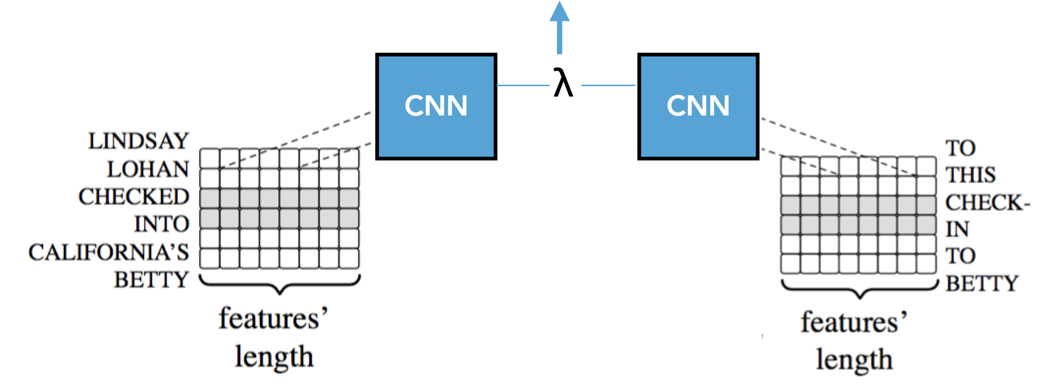
Conjoined CNN
similarity score
Cross-Document Coreference Resolution for Entities and Events. Tanner. Brown University Dissertation. 2019

Slide 54
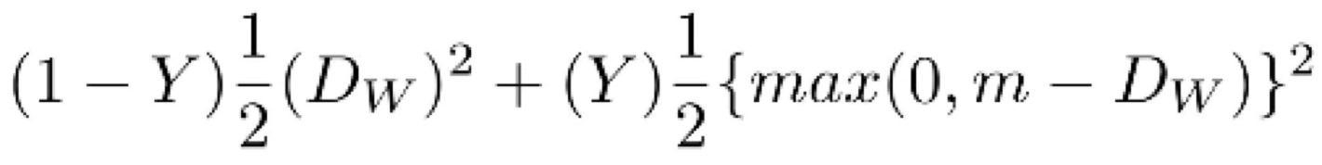
Conjoined CNN
Distance Score: L² norm
Loss Function: Contrastive Loss
Two identical networks with tied weights
Cross-Document Coreference Resolution for Entities and Events. Tanner. Brown University Dissertation. 2019
Notes:
the goal isn’t to classify the input, but to learn how to differentiate them. the function evaluates how well the network is distinguishing b/w a pair of mentions.
Y is the gold truth.
Dw is the predicted value, per the distance function.
m is a margin value > 0 indicating that dissimilar pairs whose score is beyond this point will not contribute to the loss.
Minimising the squared error is equivalent to predicting the (conditional) mean of y.

Slide 55
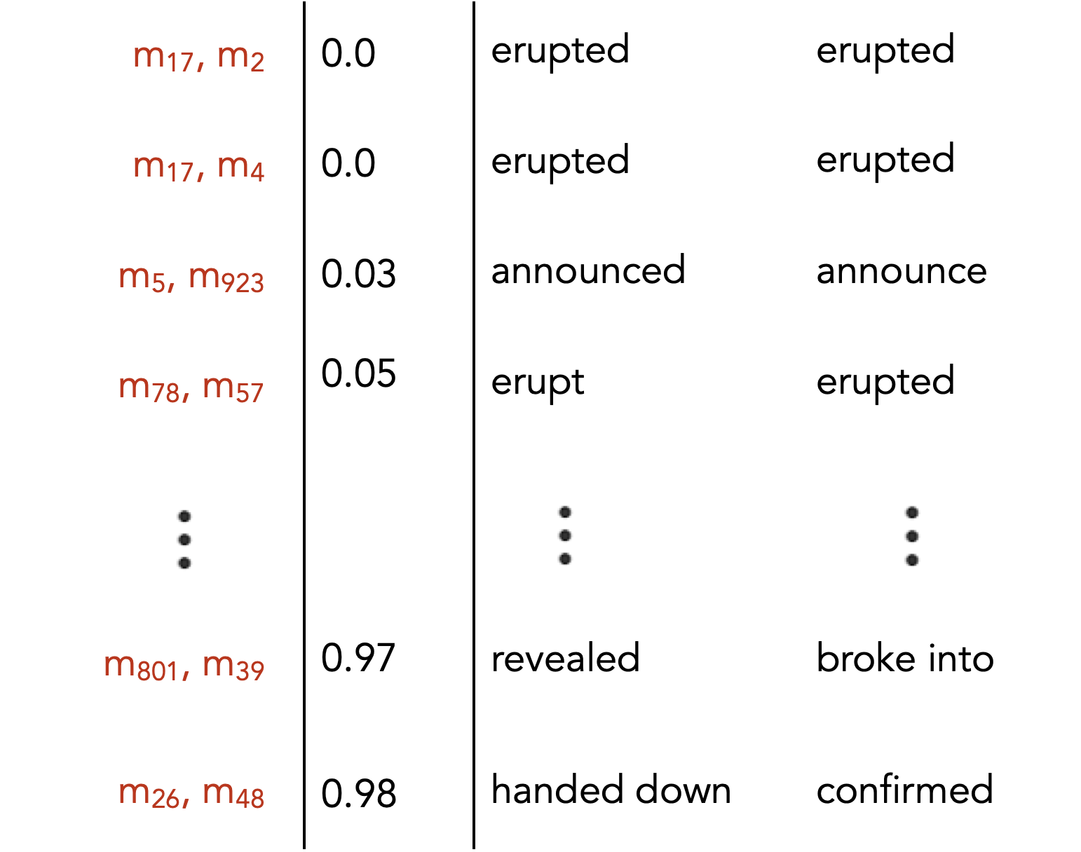
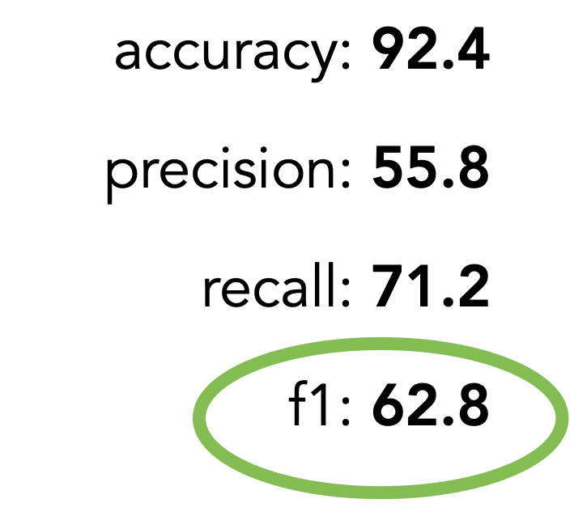
Conjoined CNN
We predict these should coref as pairs
0.5 threshold
We predict these should NOT coref as pairs

Slide 56
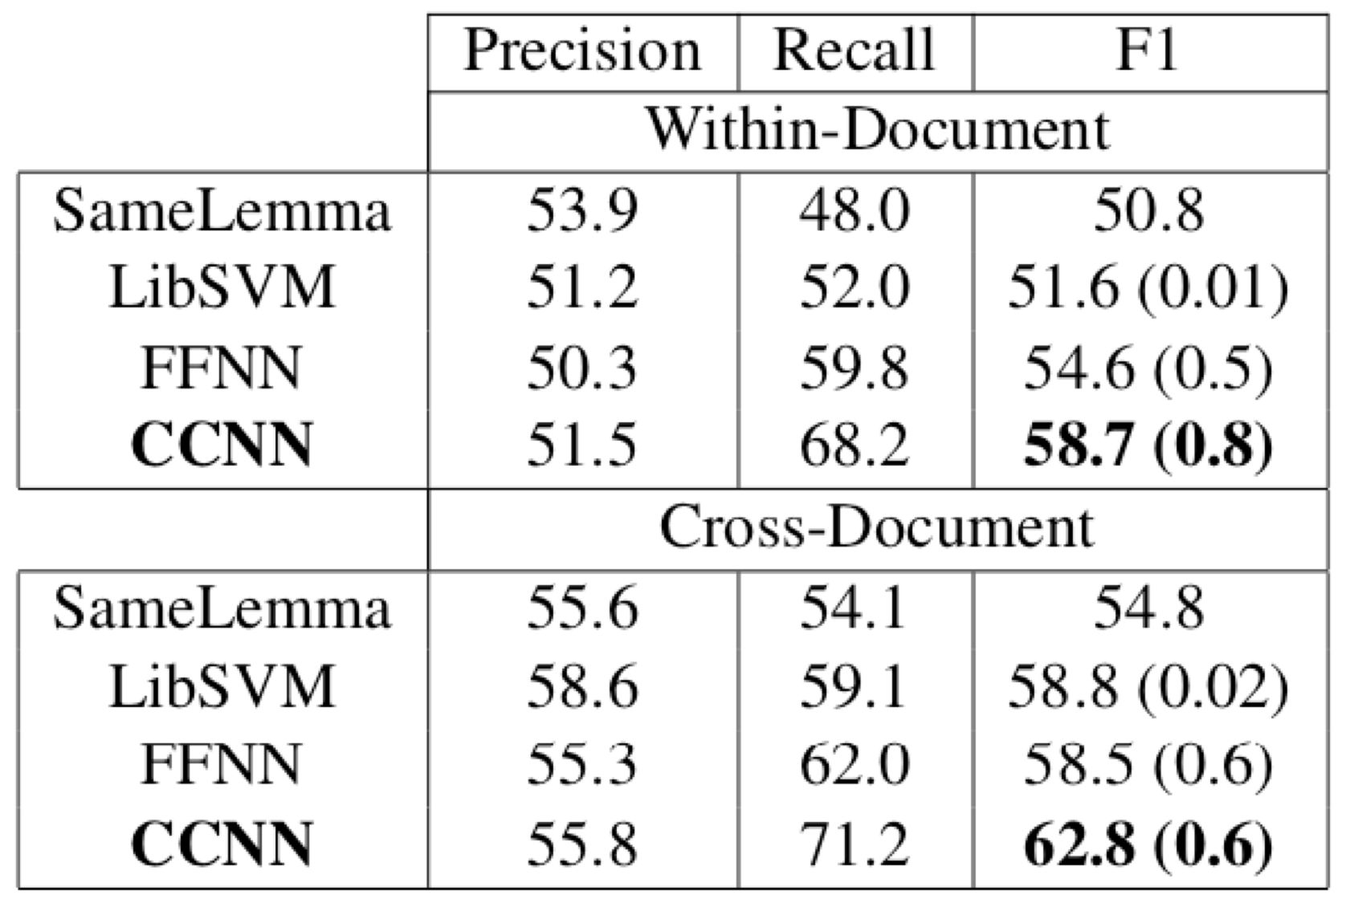
Conjoined CNN
Development Set Results
LibSVM and FFNN received same features as CCNN,
plus relational features (e.g., cosine sim., dot-product, WordNet)
Cross-Document Coreference Resolution for Entities and Events. Tanner. Brown University Dissertation. 2019

Slide 57
cluster₁
mammoth
barge
Mention
Detection
Mention
Pair Model
it
Clustering
Ever Given
its
container ship
corpus
cluster₃
Coreference resolution
Experts

Slide 58
cluster₁
mammoth
barge
Mention
Detection
Mention
Pair Model
it
Clustering
Ever Given
its
container ship
corpus
cluster₃
Coreference resolution
Experts

Slide 59
Outline
Coreference Resolution
Conjoined CNN
Neural Clustering
Results
Improvements
Leveraging Data
No Data
Better Data
Additional Research

Slide 60
Outline
Coreference Resolution
Conjoined CNN
Neural Clustering
Results
Improvements
Leveraging Data
No Data
Better Data
Additional Research

Slide 61
Clustering
Goal is to return clusters from the fully-connected graph
0.9
shook
shook
0.71
0.2
0.2
0.73
recorded
0.08
rattles
0.82
0.52
0.23
0.15
according to
rattles
0.12

Slide 62
Clustering
Goal is to return clusters from the fully-connected graph
0.9
shook
shook
0.73
recorded
rattles
0.82
according to
rattles

Slide 63
Clustering
Nearly 100% of past systems simply performed agglomerative clustering.
We want:
More holistic, cluster-to-cluster predictions
Less sensitivity to non-uniformity across topics
No additional stopping parameter
Prevention against an all-subsuming cluster

Slide 64
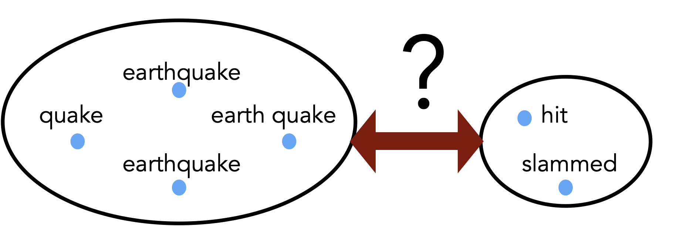
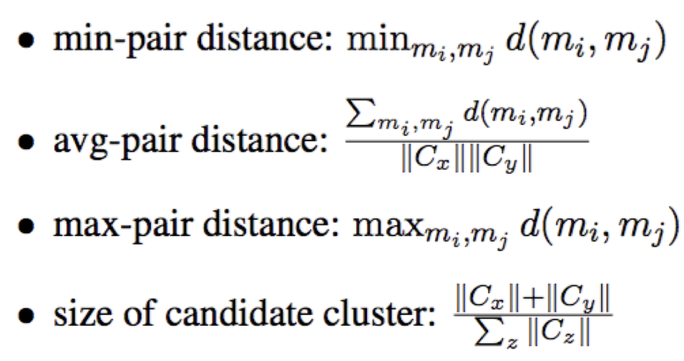
Clustering
Cross-Document Coreference Resolution for Entities and Events. Tanner. Brown University Dissertation. 2019

Slide 65
cluster₁
mammoth
barge
Mention
Detection
Mention
Pair Model
it
Clustering
Ever Given
its
container ship
corpus
cluster₃
Coreference resolution
Experts

Slide 66
Outline
Coreference Resolution
Conjoined CNN
Neural Clustering
Results
Improvements
Leveraging Data
No Data
Better Data
Additional Research

Slide 67
Outline
Coreference Resolution
Conjoined CNN
Neural Clustering
Results
Improvements
Leveraging Data
No Data
Better Data
Additional Research

Slide 68
Mention Detection
Gold Test Mentions
… as Peter Capaldi stepped into Matt Smith’s soon to be vacant …
Predicted Test Mentions
… as Peter Capaldi stepped into Matt Smith’s soon to be vacant …

Slide 69
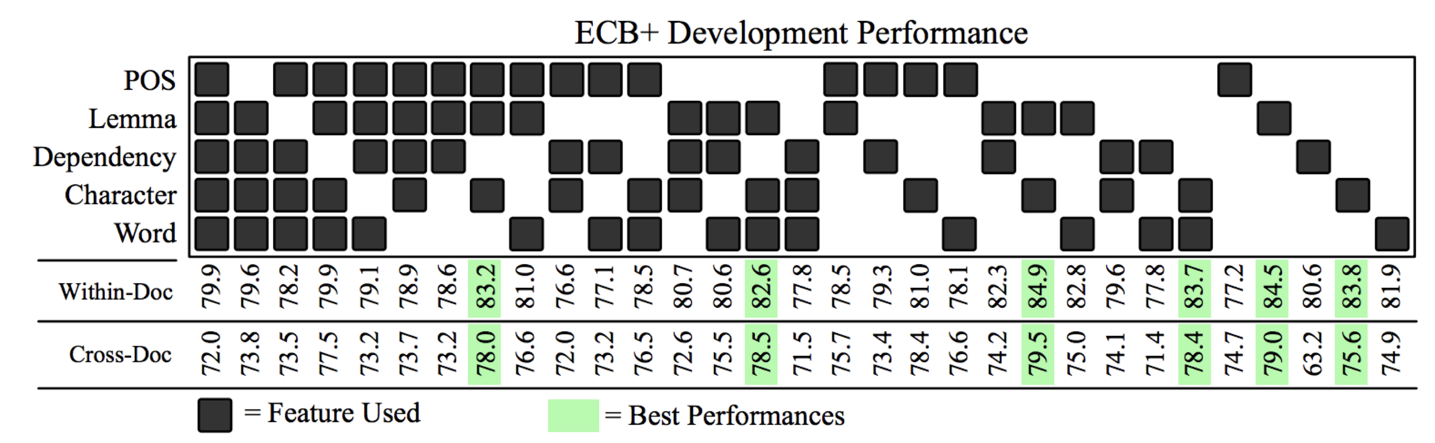
Feature Ablation (full system)
Lemma + Character Embeddings yields the best performance

Slide 70
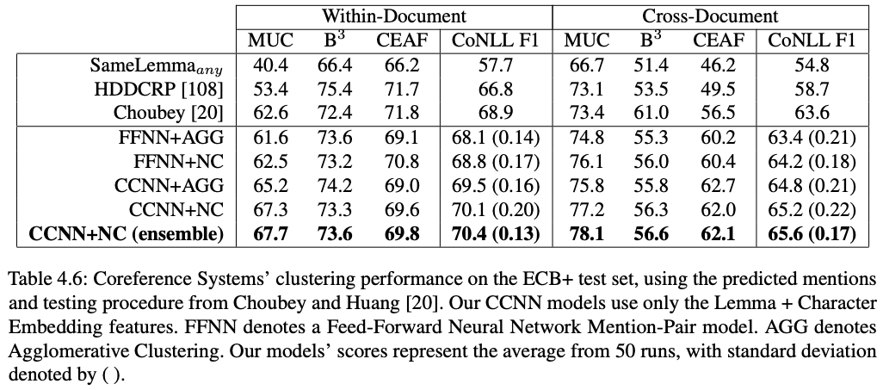
Using Predicted Mentions
Cross-Document Coreference Resolution for Entities and Events. Tanner. Brown University Dissertation. 2019

Slide 71
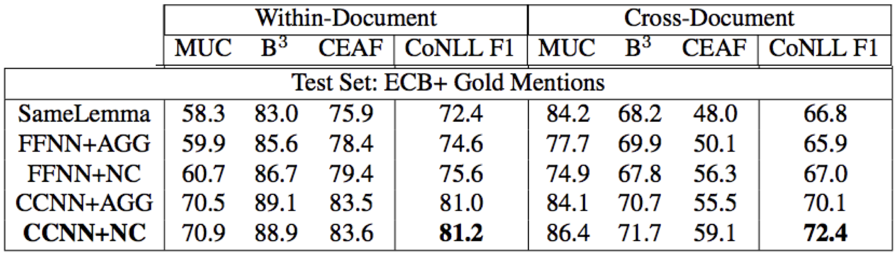
Using Gold Mentions
Cross-Document Coreference Resolution for Entities and Events. Tanner. Brown University Dissertation. 2019

Slide 72
CCNN + Clustering
FINDINGS
State-of-the-art for event coref
Contextualized representations
More holistic clustering
Char + Lemma Embeddings were the only two necessary features

Slide 73
Errors
Total # of Mention-Pairs to test: 8,669
# False Positives: 86
# False Negatives: 569
False Positives
False Negatives
semantics — 82%
context-dependent (30%)
similar meanings (38%)
wide-reading (14%)
unclear — 13%
syntax — 3%
too difficult for me — 2%
semantics — 42%
unclear — 20%
slang — 16%
longer names — 14%
pronouns — 8%

Slide 74
CCNN + Clustering
False Positive
False Negatives
Sony announced today …
The casting of Smith …
Friday, Obama announced …
Smith stepped into the role …
Smith was handed the keys to play …
False Negative
Two of the bombs fell within the Yida Camp, including …
The UN Refugee Agency on Friday strongly condemned the aerial bombing of …

Slide 75
CCNN + Clustering
False Positive
False Negatives
Takeaway #3
The community needs a better corpus.
Sony announced today …
The casting of Smith …
Friday, Obama announced …
Smith stepped into the role …
Takeaway #4
Event coref is especially hard, but using deep learning w/ contextualized representations works well.
Smith was handed the keys to play …
False Negative
Two of the bombs fell within the Yida Camp, including …
The UN Refugee Agency on Friday strongly condemned the aerial bombing of …

Slide 76
Outline
Coreference Resolution
Conjoined CNN
Neural Clustering
Results
Improvements
Leveraging Data
No Data
Better Data
Additional Research

Slide 77
Outline
Coreference Resolution
Conjoined CNN
Neural Clustering
Results
Improvements
Leveraging Data
No Data
Better Data
Additional Research

Slide 78
Entity Coreference
End-to-end neural systems
Mention
Detection
Mention
Pair Model
Clustering
End-to-end Neural Coreference Resolution. Lee et al. EMNLP 2017.

Slide 79
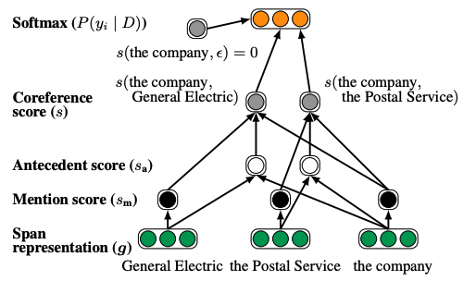
Entity Coreference
End-to-end
End-to-end Neural Coreference Resolution. Lee et al. EMNLP 2017.

Slide 80
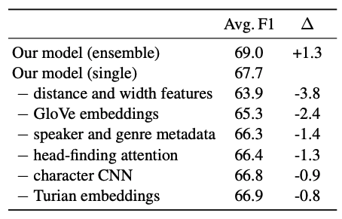
Entity Coreference
Uses several important features
End-to-end Neural Coreference Resolution. Lee et al. EMNLP 2017.

Slide 81
y₁
y₂
y₃
y₄
r₁
r₂
r₃
r₄
BERT
Encoder #3
(encodes rich information very well)
Encoder #2
Encoder #1
The
Ever
Given
has
x₁
x₂
x₃
x₄

Slide 82
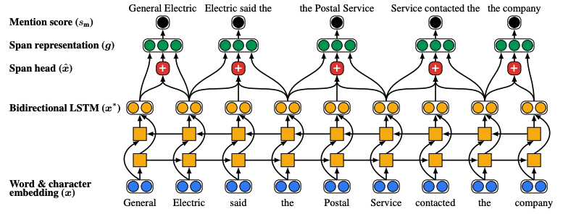
Entity Coreference
CoNLL F1: 79.6
End-to-End
Transformer (x)
BERT
BERT for Coreference Resolution: Baselines and Analysis. Joshi et al. EMNLP 2019.

Slide 83
Entity Coreference
CoNLL F1: 79.6
End-to-End
BERT for Coreference Resolution: Baselines and Analysis. Joshi et al. EMNLP 2019.

Slide 84
Entity Coreference
REMAINING ISSUES
Pronouns (especially in conversation)
Conflating relatedness with equality (e.g., “Flight attendants” with ”pilots”)
World-knowledge
Mention paraphrasing (e.g., “Royals” with “Prince Charles and his wife Camilla”)

Slide 85
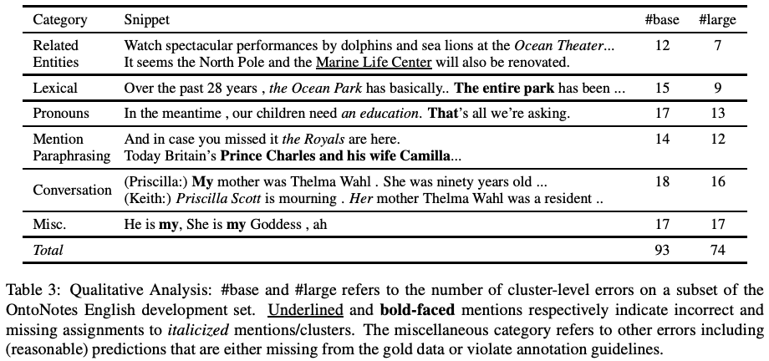
Coref is still far from solved

Slide 86
However, coref is still far from solved
Takeaway #5
Pre-trained LLM (e.g., BERT) capture rich information but miss nuanced cases

Slide 87
However, coref is still far from solved
Takeaway #5
Pre-trained LLM (e.g., BERT) capture rich information but miss nuanced cases
Takeaway #6
Until we have better data, we don’t fully understand the capabilities of our existing systems, nor do we know what is possible.

Slide 88
Takeaway #1
Coreference resolution determines which mentions all refer to the same underlying entity or event, and is ultimately a clustering task.
Takeaway #2
Research has largely relied on ML models w/ many manually-defined features. Strong results but clear limitations.
Takeaway #3
The community needs a better corpus.

Slide 89
Takeaway #4
Event coref is especially hard, but using deep learning w/ contextualized representations works well.
Takeaway #5
Neural pre-trained text encoders (e.g., BERT) capture rich information but miss nuanced cases
Takeaway #6
Until we have better data, we don’t fully understand the capabilities of our existing systems, or know what’s possible.

Slide 90
INSIGHTS
Performance is reaching an asymptote.
Instead of hammering away on a problem and throwing complex models at it, pay close attention to:
What you’re trying to model (i.e., your data)
How you’re framing the problem (e.g., a clustering task via pairwise predictions)

Slide 91
Outline
Coreference Resolution
Conjoined CNN
Neural Clustering
Results
Improvements
Leveraging Data
No Data
Better Data
Additional Research

Slide 92
Outline
Coreference Resolution
Conjoined CNN
Neural Clustering
Results
Improvements
Leveraging Data
No Data
Better Data
Additional Research

Slide 93



How can we equip our coreference resolution models with common sense knowledge?
Sahithya Ravi
Ning Hua
Vered Shwartz
UBC
PhD Student
Harvard
Bioinformatics MS
UBC
Assistant Professor

Slide 94
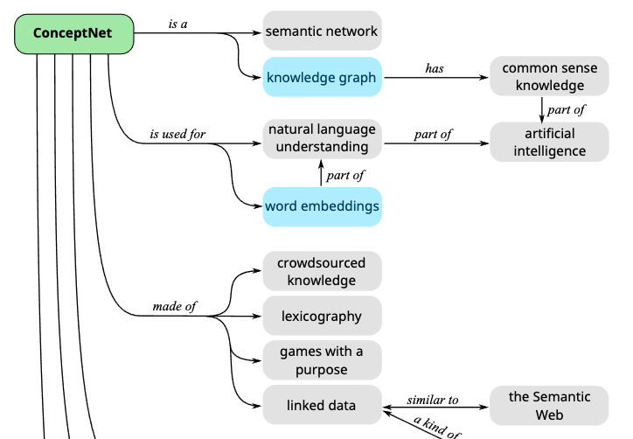
SOTA coref model uses RoBERTa as a base.
Before coref training, we fine-tune the RoBERTa base on ConceptNet

Slide 95

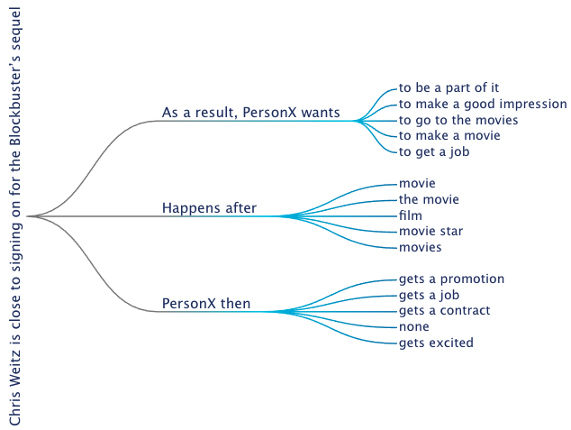
Also, using graph embeddings and graph alignments to influence coref modelling

Slide 96

Can Bayesian clustering improve joint entity and event coreference?
Joint Entity and Event Coreference
Xin Zeng
IACS MS Thesis

Slide 97
Outline
Coreference Resolution
Conjoined CNN
Neural Clustering
Results
Improvements
Leveraging Data
No Data
Better Data
Additional Research

Slide 98
Outline
Coreference Resolution
Conjoined CNN
Neural Clustering
Results
Improvements
Leveraging Data
No Data
Better Data
Additional Research

Slide 99



Since labelled data is a scarce commodity, can we build a powerful unsupervised model?
Alessandro Stolfo
Vikram Gupta
Mrinmaya Sachan
ETH-Zurich
PhD Student
ETH-Zurich
Research Affiliate
ETH-Zurich
Assistant Professor

Slide 100
We combine the old school, manual rule-based system
with the SOTA BERT-based end-to-end model
Transformer (x)
SpanBERT
A Simple and Effective Approach for Unsupervised Coreference using Pretrained Representations and Weak Supervision from Linguistic Rules. Alessandro Stolfo et al. In preparation.
Notes:
By exploiting contextualized span representations within an end-to-end learning framework, we aim for the neural model to exhibit stronger generalization capabilities.

Slide 101
We combine the old school, manual rule-based system
with the SOTA BERT-based end-to-end model
Transformer (x)
SpanBERT
Unsupervised (doesn’t need training data)
Supervised (needs training data)
A Simple and Effective Approach for Unsupervised Coreference using Pretrained Representations and Weak Supervision from Linguistic Rules. Alessandro Stolfo et al. In preparation.

Slide 102
We combine the old school, manual rule-based system
with the SOTA BERT-based end-to-end model
Let’s use this as synthetic “gold” labels for BERT
Transformer (x)
BERT
Unsupervised (doesn’t need training data)
Supervised (needs training data)
A Simple and Effective Approach for Unsupervised Coreference using Pretrained Representations and Weak Supervision from Linguistic Rules. Alessandro Stolfo et al. In preparation.

Slide 103
CONCERN
Training with noisy (imperfect) rule-based labels would limit our BERT model to perform no better than the rule-based system
A Simple and Effective Approach for Unsupervised Coreference using Pretrained Representations and Weak Supervision from Linguistic Rules. Alessandro Stolfo et al. In preparation.

Slide 104
CONCERN
Training with noisy (imperfect) rule-based labels would limit our BERT model to perform no better than the rule-based system
FINDINGS
Our combined BERT model successfully uses distant-supervision to outperform the rule-based system
A Simple and Effective Approach for Unsupervised Coreference using Pretrained Representations and Weak Supervision from Linguistic Rules. Alessandro Stolfo et al. In preparation.

Slide 105
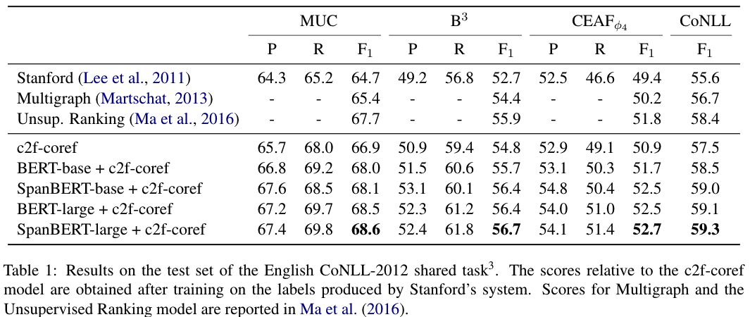
A Simple and Effective Approach for Unsupervised Coreference using Pretrained Representations and Weak Supervision from Linguistic Rules. Alessandro Stolfo et al. In preparation.

Slide 106
Outline
Coreference Resolution
Conjoined CNN
Neural Clustering
Results
Improvements
Leveraging Data
No Data
Better Data
Additional Research

Slide 107
Outline
Coreference Resolution
Conjoined CNN
Neural Clustering
Results
Improvements
Leveraging Data
No Data
Better Data
Additional Research

Slide 108
Outline
Coreference Resolution
Conjoined CNN
Neural Clustering
Results
Improvements
Leveraging Data
No Data
Better Data
Additional Research

Slide 109
Conclusions
Coreference Resolution has had many exciting advances in the last 10 years, but it’s far from solved and remains one of the most challenging and exciting NLP tasks.

